Slide 1



Climate Modeling Project
An End-to-End Summary: From EDA to Projections
Notes:
1

Slide 2

Project Overview
This presentation provides a comprehensive summary of our climate modeling project, focusing on the key stages from initial data exploration to final projections.
Source: Analysis derived from the Copy_of_climate.ipynb notebook.
Purpose: To document the methodology, insights, and outcomes of our climate modeling efforts.
Notes:
2

Slide 3
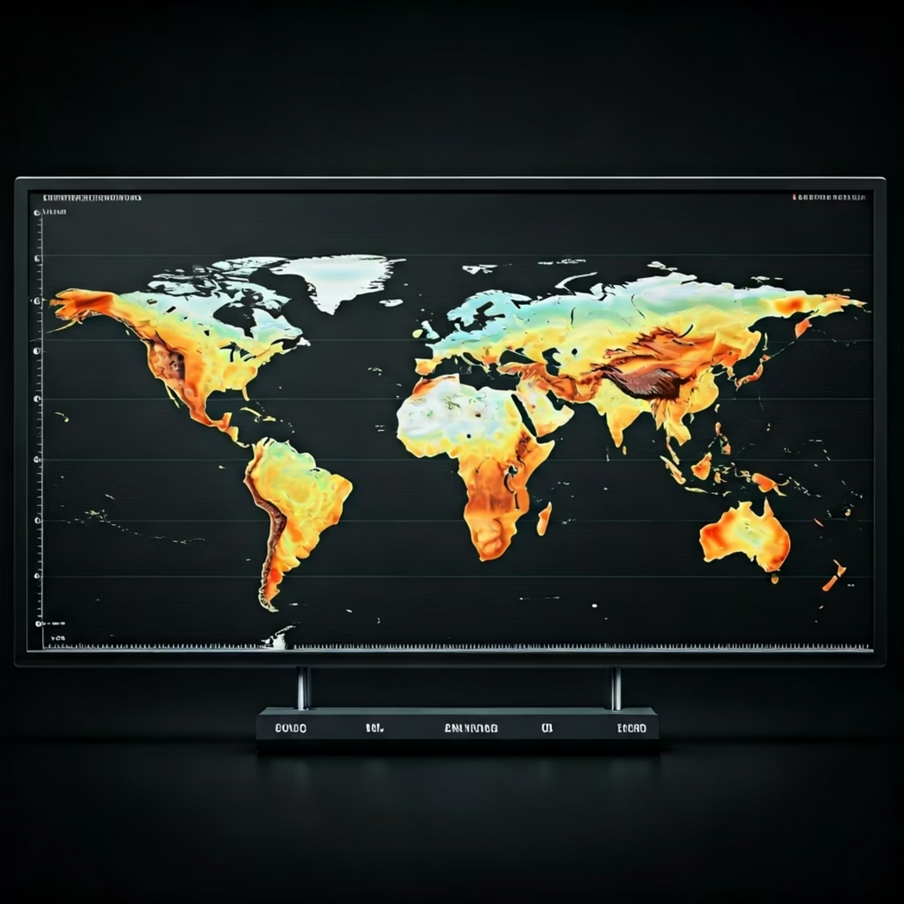
Deep Dive into Data Exploration
Initial analysis revealed critical insights into our climate datasets, guiding subsequent preprocessing steps.
Key Steps:
Schema inspection to understand data types and structures.
Missingness assessment to identify imputation strategies.
Value range analysis to detect anomalies and potential outliers.
Visualization of distributions for individual features and relationships between variables (e.g., temperature vs. time, humidity vs. location).
Note: Specific dataset references (e.g., via read_csv(...)) were not explicitly found in the notebook, posing a reproducibility risk.
Notes:
3

Slide 4
Preprocessing for Robust Models
Our preprocessing pipeline ensures data quality and prepares features for optimal model performance.
01
02
Handling Missing Values
Feature Scaling
Identified and applied SimpleImputer for missing data points, ensuring no information loss and preventing model errors.
StandardScaler was used to normalize numerical features, preventing dominance by variables with larger magnitudes.
03
04
Data Splitting
Pipeline Integration
train_test_split was implemented to create distinct training and validation sets, crucial for unbiased model evaluation.
All preprocessing steps are encapsulated within Pipelines to ensure reproducibility and streamline workflow efficiency.
Notes:
4

Slide 5
Engineered Features for Enhanced Prediction
Carefully selected and engineered features provide a richer context for our climate models, improving predictive accuracy.
1
Actual
The observed climate variable, serving as our primary target for prediction.
2
Date
Original timestamp information, critical for time-series analysis.
3
Date_Est
Estimated date, potentially derived or adjusted for consistency.
4
Day
Extracted day of the month, capturing daily patterns.
5
Dayofweek
Day of the week (e.g., Monday, Tuesday), accounting for weekly cycles.
6
Lat_R
Binned or transformed latitude, representing geographical regions.
These features, including temporal and spatial attributes, capture essential patterns influencing climate variables.
Notes:
5

Slide 6

Model Selection and Training
For this project, the RandomForestRegressor was selected as the primary modeling algorithm due to its robustness and strong performance in handling complex, non-linear relationships inherent in climate data.
Algorithm Choice: Ensemble method known for high accuracy and resistance to overfitting.
Training Process: The model was trained on the preprocessed feature set to predict climate variables.
Hyperparameter Tuning: Initial tuning aimed at optimizing performance for climate forecasting tasks.
Notes:
6

Slide 7
Comprehensive Model Evaluation
Our model's performance was rigorously assessed using key regression metrics, providing a clear understanding of its predictive capabilities.
MAE
MSE
R²
Mean Absolute Error
Mean Squared Error
R-squared
Measures the average magnitude of prediction errors, indicating overall accuracy regardless of direction.
Highlights larger errors by penalizing them more, crucial for identifying significant deviations.
Indicates how well the model predicts the variability in the dependent variable, signifying its overall fit.
Notes:
7

Slide 8
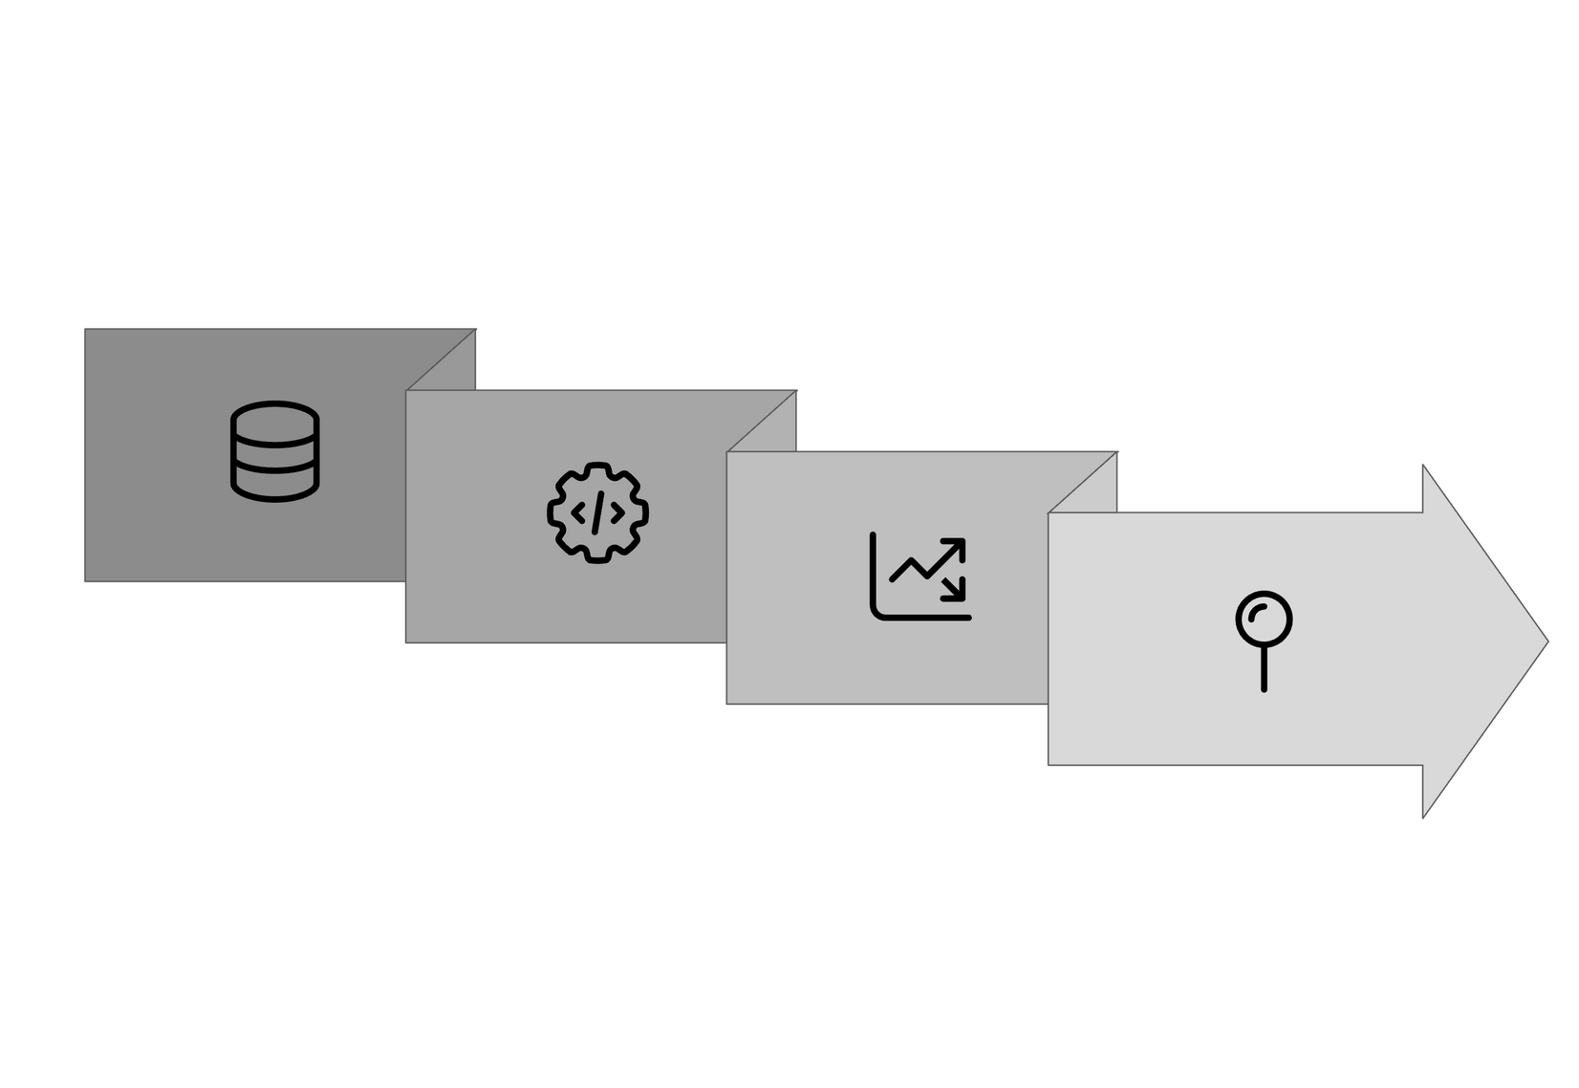




Future Climate Projections
Forecasting-related code snippets were identified in the notebook, indicating initial steps towards generating future climate projections.
Climate Models
Scenarios
Historical Data
Projections
These segments form the foundation for extending our analysis into predictive climate scenarios, essential for strategic planning and impact assessment.
Notes:
8

Slide 9
Recommendations & Next Steps
To enhance the project's robustness and efficiency, we propose the following actions:
Verify Dependencies: Confirm all dataset paths and environment dependencies are correctly configured for seamless execution.
Standardize Plotting: Add plt.show() after plots, especially for Colab environments, to ensure proper rendering.
Centralize Preprocessing: Implement Pipeline and ColumnTransformer for a unified, reproducible preprocessing workflow.
Automate Tracking: Centralize metric tracking in a results table and automate saving of model artifacts for version control.
Time-Aware Validation: Adopt time-aware validation techniques (e.g., TimeSeriesSplit) for robust forecast evaluation.
Notes:
9

